Slide 2
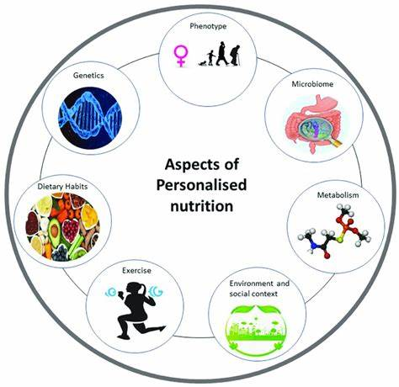
Personalized nutrition is revolutionizing health management by tailoring dietary recommendations based on genetic makeup, metabolic health, and lifestyle factors.
Nutrigenomics research underscores the importance of understanding genetic variations and their impact on nutrient metabolism, enabling more effective and targeted dietary interventions.
Advances in precision nutrition emphasize the need to consider individual metabolic profiles when developing dietary plans, as people respond differently to the same nutrients.
The integration of big data and machine learning in healthcare applications has facilitated the creation of personalized nutrition programs that adapt to individual needs in real-time.
Healthcare apps utilizing advanced algorithms can analyze data from genetic testing, lifestyle monitoring, and metabolic profiling to provide customized, actionable dietary advice.
By leveraging insights from nutrigenomics and precision nutrition, personalized dietary plans aim to improve health outcomes, prevent chronic diseases, and enhance adherence to nutritional recommendations.
Background

Slide 3
Aim
This project aims to develop and evaluate a food recommendation application that uses personalized dietary guidance to encourage better eating habits and enhance general health outcomes. The program's goal is to provide personalized meal recommendations based on each user's individual requirements and preferences by utilizing cutting-edge machine learning algorithms and user-centric design techniques. To provide individualized nutrition recommendations, the program will combine data from multiple sources, such as genetic information, dietary practices, health indicators, and lifestyle factors. The software will improve its recommendations through ongoing learning and modification to better suit users' changing preferences and health objectives. The ultimate objective is to enable customers to make knowledgeable food decisions and sustainable lifestyle adjustments that promote their long-term wellbeing. The app aims to improve user engagement and commitment to good eating habits by offering useful insights and easy-to-use meal planning tools. By showcasing the effectiveness of tailored nutrition interventions, this research aims to advance both individual health outcomes and more general public health goals. Ultimately, the goal of this project is to empower users to take control of their health through personalized nutrition. By providing scientifically-backed, individualized meal plans and fostering a deeper understanding of healthy eating practices, the application aims to support users in achieving their long-term wellbeing and enhancing their quality of life.

Slide 4
Objectives
Develop a personalized food recommendation system that integrates user-specific health profiles, lifestyle preferences, and genetic data to provide tailored dietary advice.
Collect and securely manage comprehensive user data on eating habits, health metrics (such as blood sugar, cholesterol, and BMI), and lifestyle choices to ensure accurate and personalized recommendations.
Design and implement advanced machine learning algorithms that analyze collected data to generate customized meal suggestions, utilizing reinforcement learning for continuous optimization and clustering techniques to identify similar dietary needs among users.
Create a user-friendly and engaging interface that allows users to input their data, receive personalized meal recommendations, and provide feedback, ensuring high user satisfaction and retention.
Evaluate the application's effectiveness in promoting healthier eating practices by analyzing user engagement metrics, health outcome improvements, and user satisfaction through qualitative feedback.
Conduct ongoing usability testing and performance analysis to identify and address functional and design improvements, ensuring compliance with ethical standards and regulatory requirements.

Slide 5
Research Problem
The rise in diet-related health issues such as diabetes, obesity, and heart disease underscores the need for more effective dietary strategies that consider individual differences.
Traditional dietary guidelines often fail to account for variations in genetics, metabolism, and personal preferences, leading to suboptimal health outcomes for many individuals.
This research aims to develop a meal recommendation application that offers personalized dietary advice to promote healthier eating habits and improve overall health.
Advances in nutrigenomics reveal that genetic differences significantly impact how individuals metabolize nutrients, influencing their response to dietary fats and risk of cardiovascular diseases.
The study will leverage machine learning to create dynamic, customized dietary recommendations that adapt to users' evolving health metrics and preferences, addressing the shortcomings of generic dietary guidelines.
Ensuring the application’s effectiveness, user satisfaction, and long-term engagement will be critical to its success in promoting better eating practices and achieving positive health outcomes.

Slide 6
Research Questions
How can a food recommendation app be created to offer customized dietary advice depending on each user's tastes and health profile?
Based on user data analysis, which machine learning algorithms produce the most individualized dietary recommendations?
How do users' eating habits, engagement, satisfaction, and health outcomes change as a result of the meal suggestion application?
Based on user feedback, what are the application's functional and design strengths and areas for improvement?
What steps must be taken to adhere to data protection laws, and how can the application guarantee the safe and moral processing of user data?
What attributes and tactics can be used to encourage sustained user participation and adherence to individualized dietary advice?
How can the accuracy and customisation of nutritional advice be improved by integrating data from wearable devices?

Slide 7
Research Design Components
The research design incorporates several critical components that contribute to the development and evaluation of the meal recommendation application.
Data collection methods include focus groups, questionnaires, interviews, and health measurements to gather information on user health profiles, food preferences, usage patterns, and feedback.
Machine learning algorithms will be developed to analyze user data and generate personalized dietary recommendations, requiring the selection, training, and testing of appropriate algorithms.
Techniques like reinforcement learning, clustering, and supervised learning will be employed to ensure the recommendations are accurate and relevant to users.
The application’s design and development will follow phases such as requirement analysis, design, development, and testing, with a focus on user-centric design principles.
Evaluating the application's effectiveness involves assessing its impact on adherence to dietary guidelines, encouraging healthier eating habits, and enhancing user satisfaction.
Evaluation methods will include usability testing, user interviews, surveys, and tracking health metrics to gauge the application’s success.
Ensuring the security and ethical handling of user data is paramount, with measures such as obtaining informed consent, protecting user privacy, and complying with data protection regulations.
The application’s sustainability relies on features and strategies designed to foster long-term user engagement and adherence to personalized dietary recommendations.
The integration of data from wearable devices will be explored to enhance the accuracy and personalization of nutritional advice, contributing to a more comprehensive health management approach.

Slide 8
Literature Study
Personalized Nutrition
The emerging field of personalized nutrition aims to tailor dietary guidelines to the unique needs of individuals, considering differences in metabolism, genetics, and lifestyle.
Unlike traditional dietary recommendations, which are often broad and generic, personalized nutrition recognizes that a one-size-fits-all approach may not be effective for everyone.
By considering each person's unique characteristics, this approach seeks to optimize dietary interventions and enhance the effectiveness of nutrition plans in promoting health and preventing disease (Aruoma et al., 2019).
Personalized nutrition leverages advancements in nutrigenomics—the study of the interaction between genes and nutrition—to understand how individuals respond differently to various nutrients.
Genetic variations can influence how a person metabolizes fats, carbohydrates, and other nutrients, impacting overall health outcomes (Drabsch & Holzapfel, 2019).
Machine Learning in Health Applications
Machine learning (ML), a branch of artificial intelligence (AI), is revolutionizing healthcare by enabling the analysis of large and complex datasets to uncover patterns, predict outcomes, and provide personalized recommendations.
In personalized nutrition, ML allows for tailored dietary recommendations by analyzing individual health data, such as genetic information, wearable device data, and electronic health records (EHRs) (Ngiam & Khor, 2019).
By integrating these diverse data sources, ML models can generate insights that were previously unattainable, leading to more accurate and personalized healthcare interventions (Tohka & Van Gils, 2021).
ML algorithms, such as classification and clustering, are particularly effective in identifying patterns and grouping individuals with similar health profiles, enabling the creation of tailored dietary plans and interventions.
Reinforcement learning, a subset of ML, offers significant potential in continuously refining dietary recommendations based on real-time user feedback, ensuring that nutritional advice remains relevant over time (Nurmi & Lohan, 2021).

Slide 9
Evaluation of Health Applications
User-Centric Design in Health Applications
User-centric design is crucial in developing health applications, focusing on creating tools that are functional, engaging, intuitive, and tailored to users' unique needs and preferences (Koumpouros, 2022).
This design approach begins with understanding users through research methods like interviews, surveys, and observations, ensuring that applications resonate with their needs and preferences (Banton et al., 2021).
The iterative process of prototyping and testing is essential, as it involves creating early versions of the application, gathering user feedback, and refining the design to enhance usability and engagement (Koumpouros, 2022).
Usability testing helps identify and address potential issues in navigation and functionality, improving the user experience and ensuring the application is easy to use and effective (Banton et al., 2021).
For food recommendation applications, user-centric design involves customizable features and interactive interfaces, allowing users to tailor recommendations to their dietary preferences and health goals (TANIS & DAUKSAITE, 2022).
Assessing the efficacy of health applications is essential to verify that they effectively enhance user health and well-being, using a multifaceted approach to evaluate user satisfaction, engagement, and health outcomes.
Key criteria for evaluation include user retention rates, adherence to dietary guidelines, and changes in health markers such as blood glucose, weight, and cholesterol levels.
User engagement is a primary measure of an application's success, with metrics like daily active users, session duration, and frequency of use indicating how valuable and likely to be continued the app is.
User satisfaction can be gauged through questionnaires and feedback forms, which assess usability, convenience, and perceived benefits (Abd-Alrazaq et al., 2020).
Both qualitative and quantitative techniques, such as surveys, interviews, and performance indicators, are used to assess the effectiveness of the application, while machine learning algorithms' efficacy can be evaluated using metrics like accuracy, precision, recall, and F1 score (Nurmi & Lohan, 2021).

Slide 10
Ethical and Regulatory Considerations
The use of AI and machine learning in health applications raises ethical and legal issues, particularly concerning data protection, informed consent, and algorithmic transparency.
Given the sensitivity of health data, stringent privacy regulations are essential, requiring robust data encryption and secure storage to protect against breaches and unauthorized access (Kasula, 2021).
Informed consent is critical; users must be fully aware of how their data will be used, shared, and stored, with clear options to opt-in or opt-out of data collection (Kasula, 2021).
Algorithmic transparency is necessary to allow users to understand the decision-making processes of AI systems, helping to identify and mitigate biases and ensuring accountability (Kasula, 2021).
Adhering to regulatory standards, such as the General Data Protection Regulation (GDPR), is vital for protecting user rights and ensuring ethical practices in health applications (Nasir, Khan & Bai, 2024; Elendu et al., 2023).
Nutrigenomics and Personalized Diets
Nutrigenomics explores the interaction between genetics and nutrition, aiming to develop personalized dietary recommendations based on individual genetic variations, thereby enhancing health outcomes and preventing disease (Drabsch & Holzapfel, 2019).
This field recognizes that genetic differences influence nutrient metabolism and disease susceptibility, highlighting the need for personalized dietary advice rather than generic guidelines (Aruoma et al., 2019).
Implementing nutrigenomics involves genetic testing to tailor dietary plans to an individual's genetic profile, which has shown success in managing weight loss and optimizing overall well-being (Holzapfel et al., 2021).
Challenges in nutrigenomics include the complexity of gene-diet interactions and ethical concerns surrounding genetic data privacy, which necessitate careful consideration and robust regulatory frameworks (Zeisel, 2020; Nasir, Khan & Bai, 2024).
The future of nutrigenomics is promising, with advancements in technology and data science potentially revolutionizing personalized nutrition through AI, wearable technology, and more accessible genetic testing (Ngiam & Khor, 2019; Nurmi & Lohan, 2021).

Slide 11
Methodology
Research Design
This study adopts a quantitative research design, which is ideal for analyzing numerical data and identifying patterns within large datasets. The primary aim is to develop a robust methodology that supports the creation of a personalized nutrition application, which will offer tailored dietary advice based on individual needs and preferences. The research design incorporates data collection, preprocessing, analysis, and visualization phases, ensuring a comprehensive approach to understanding and utilizing nutritional data. By focusing on the systematic collection and analysis of nutritional information from various food categories, the study seeks to provide data-driven insights that will inform the application's recommendation engine. The design is both descriptive, as it details the nutritional content of numerous food items, and inferential, as it aims to predict user dietary behaviors and outcomes based on observed data patterns.
Hypotheses
The study is guided by several hypotheses that shape the analytical focus and framework. The first hypothesis (H1) suggests that there is a significant correlation between food categories and their average caloric content per 100 grams, positing that certain categories consistently exhibit higher or lower caloric densities. The second hypothesis (H2) asserts that food items with higher caloric content are predominantly found in specific categories, such as Potato Products and Dried Fruits. The third hypothesis (H3) proposes that the relationship between calories and kilojoules can be effectively modeled using linear regression, providing a reliable method for converting between these two energy units. The fourth hypothesis (H4) examines the potential of time-series analysis to reveal significant trends and patterns in dietary habits, which could be used to predict future eating behaviors. Lastly, the fifth hypothesis (H5) posits that personalized dietary recommendations, informed by both descriptive and inferential statistics, will lead to improved health outcomes for users.

Slide 12
Data Collection
Data collection for this study involved gathering comprehensive nutritional information on a wide array of food items, covering categories such as Canned Fruits, Fresh Fruits, Tropical & Exotic Fruits, Potato Products, and Vegetables. Each food item is associated with key nutritional attributes, including calories, kilojoules, and standardized serving sizes per 100 grams. The data was sourced from established nutrition databases, known for their accuracy and reliability, and compiled into a structured CSV file format. To ensure the data's integrity, a cross-validation process was conducted, comparing nutritional values across multiple sources. This rigorous data collection process ensures that the dataset is both comprehensive and accurate, providing a solid foundation for subsequent analyses.
Sampling
The study employs purposive sampling, a non-probability sampling technique that allows for the intentional selection of food items most relevant to the research objectives. This approach ensures that the sample includes a diverse array of food categories, which is critical for generating personalized dietary recommendations applicable to a wide audience. The sample was selected to represent a broad spectrum of caloric content, from low-calorie vegetables to high-calorie items like Potato Products and Dried Fruits, reflecting the variety of foods that users might consume. By focusing on foods that are commonly consumed and readily available, the study ensures that its findings will be broadly applicable and useful in a real-world context.
Data Pre-processing
Data pre-processing is a vital step in preparing the raw data for analysis, ensuring that it is clean, consistent, and appropriately structured. This process includes several key tasks: data cleaning, which involves identifying and correcting errors such as missing values and duplicate entries; standardization, which ensures that all measurements, particularly serving sizes, are consistent across the dataset; normalization, which scales the data within a common range to facilitate meaningful comparisons; and categorization, which groups food items into predefined categories like Fruits, Vegetables, and Potato Products. These preprocessing steps are essential for ensuring the quality and reliability of the data, which directly supports the accuracy of the statistical analyses and the validity of the study’s findings.

Slide 13
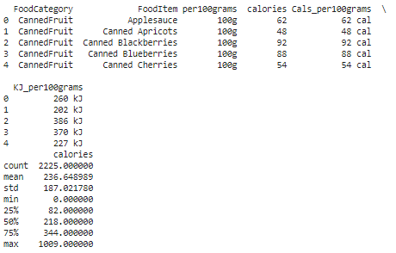
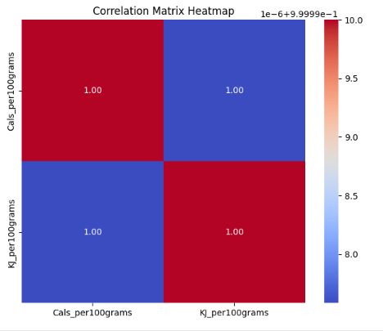
Analytical Methods
The study utilizes a combination of analytical methods to explore relationships within the nutritional data and generate insights that inform personalized dietary recommendations. Correlation analysis is used to assess the strength and direction of relationships between nutritional attributes, such as calories and kilojoules, across different food categories. Regression models, particularly linear regression, are employed to predict relationships between variables, such as converting calories to kilojoules. Time-series analysis is conducted to examine trends in caloric intake over time, providing insights into how dietary habits evolve. Descriptive analysis summarizes the dataset, offering an overview of the distribution of calories, kilojoules, and other nutritional metrics across food categories. These analytical methods provide a statistical foundation for understanding the data and developing the application’s recommendation engine.
Variable Data
The study’s analysis is based on several key variables derived from the nutritional attributes of food items. The primary variables include Food Category, which indicates the food group (e.g., Fruits, Vegetables, Potato Products); FoodItem, representing the specific food name; Calories, which measures the energy content per 100 grams in kilocalories; Kilojoules, another measure of energy content per 100 grams, used alongside calories; and Serving Size, which is standardized to 100 grams to ensure consistency across the dataset. These variables are critical for conducting statistical analyses and generating insights that inform personalized dietary recommendations.

Slide 14
Visual Analysis
Visual analysis is a crucial component of the research methodology, as it translates complex statistical data into intuitive and accessible visual representations. Various types of charts and graphs, including bar charts, pie charts, line charts, and radar charts, are used to visualize different aspects of the nutritional data. For instance, bar charts are employed to compare average calories per 100 grams across different food categories, while pie charts visualize the distribution of energy content in kilojoules. Line charts compare calories and kilojoules for individual food items, and radar charts are used to compare the caloric content of different potato-based products. These visualizations are integral to making the data understandable and actionable for users, supporting the development of personalized dietary recommendations in the application.
Model Validation and Evaluation
Model validation and evaluation are critical steps to ensure the reliability and accuracy of the statistical models and visualizations developed in this study. The models, including regression models and time-series analyses, are validated using techniques such as cross-validation, where the data is partitioned into training and testing sets to assess the models' generalizability. Evaluation metrics such as R-squared, mean squared error (MSE), and root mean squared error (RMSE) are used to quantify the models' performance. These metrics help to ensure that the models provide accurate predictions and insights that can be used to inform dietary recommendations. The visualizations are also evaluated for their clarity and effectiveness in conveying data insights, ensuring that they enhance the user experience within the personalized nutrition application. This comprehensive validation and evaluation process ensures that the models and visualizations are robust, reliable, and capable of supporting accurate and personalized dietary guidance.
Evaluation of Effectiveness and User Satisfaction
This goal focuses on determining the effectiveness of the AI/ML-powered application in providing tailored meal suggestions and measuring its impact on users' dietary habits and overall health results. The project's goal is to evaluate the application's effectiveness in promoting healthier food choices and improving user well-being over time by implementing user feedback mechanisms and analyzing performance metrics such as user engagement, satisfaction surveys, and adherence to recommended dietary changes. By carefully addressing these objectives, the project aims to create a cutting-edge AI/ML-powered application that not only answers users' needs for tailored meal recommendations, but also helps to improve their dietary habits and overall health outcomes.

Slide 15
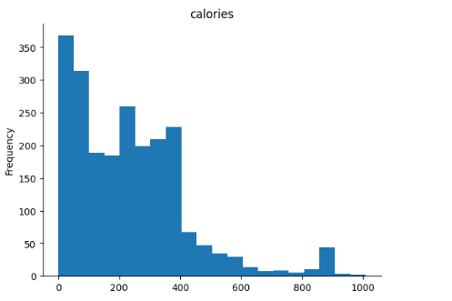
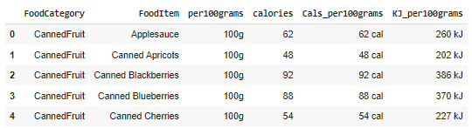
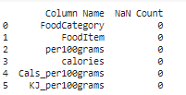
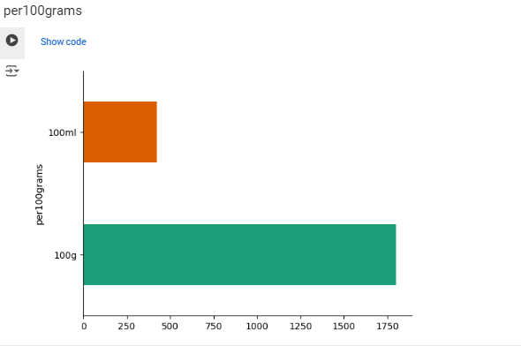
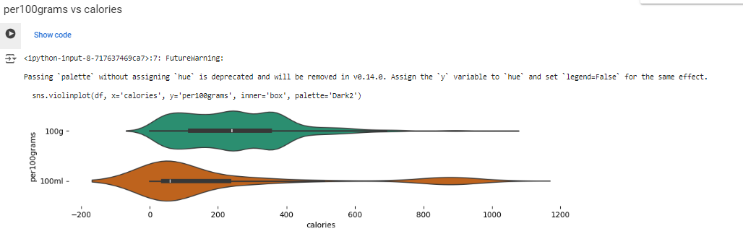
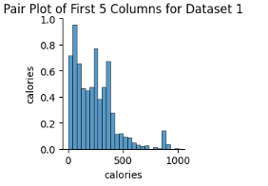
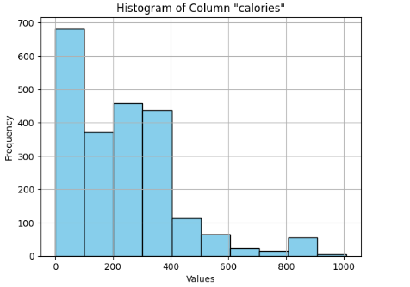
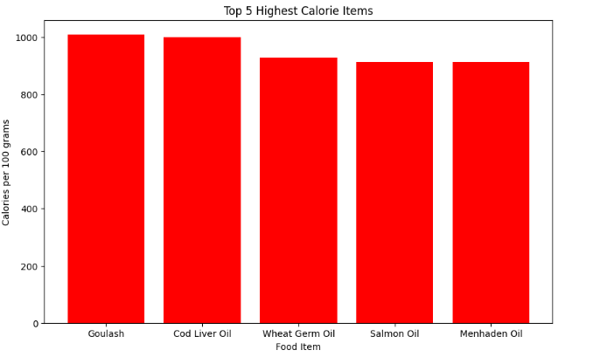
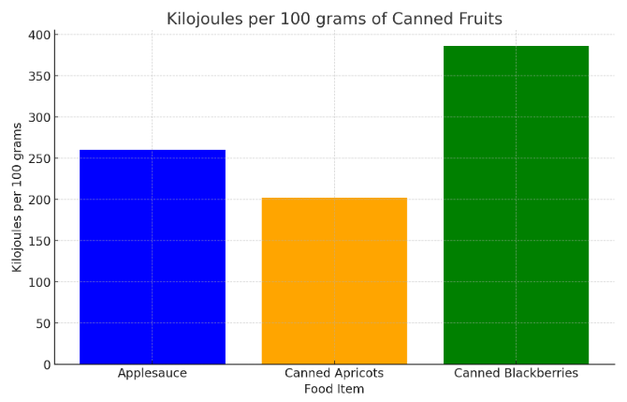
Data Analysis

Slide 16
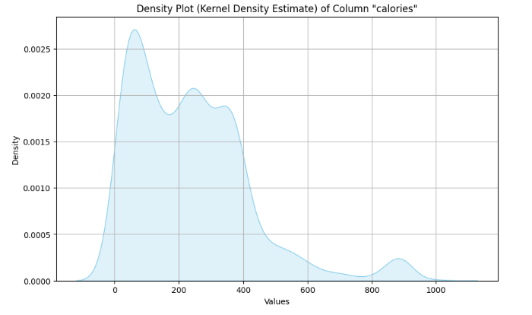
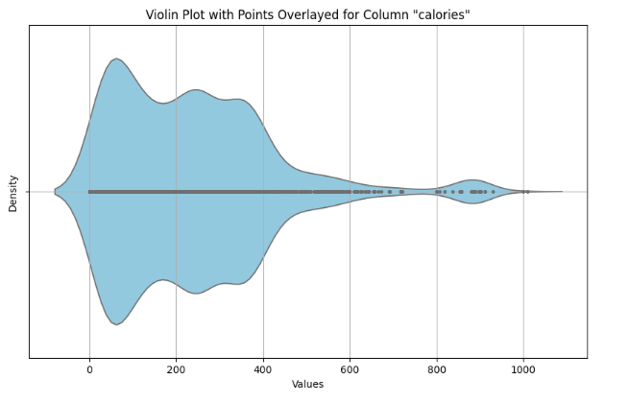
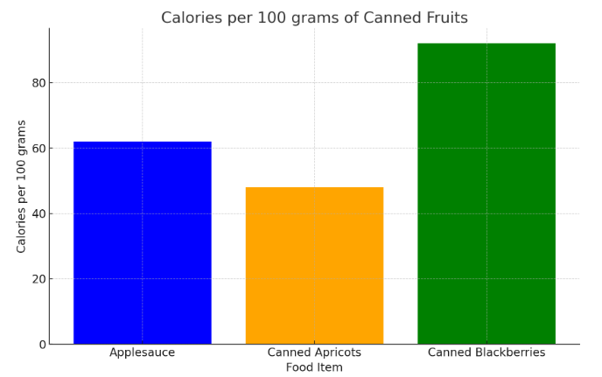
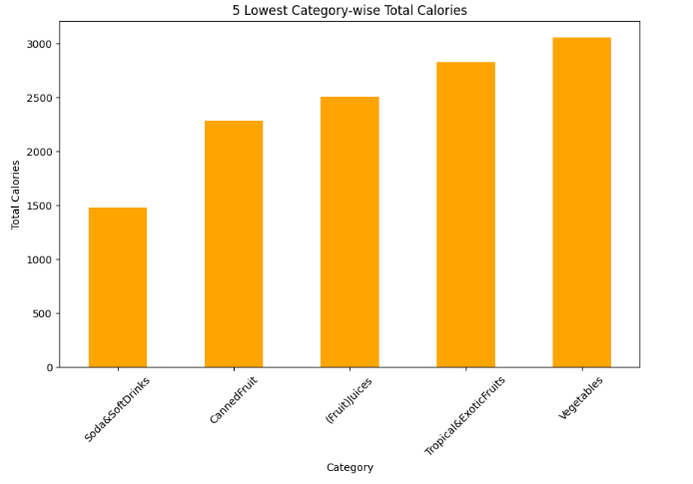
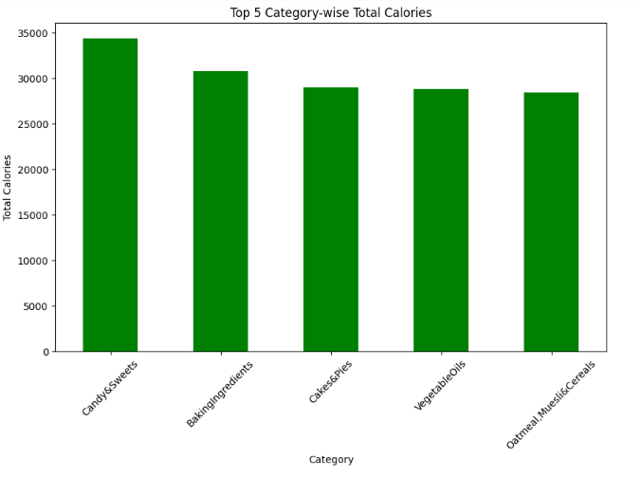
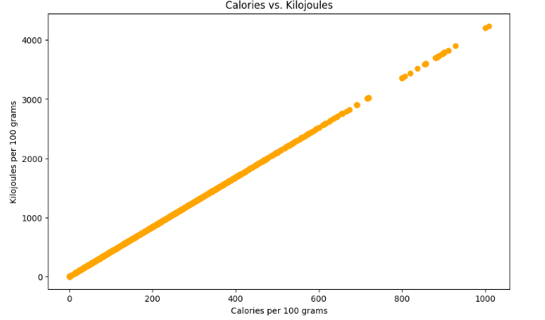
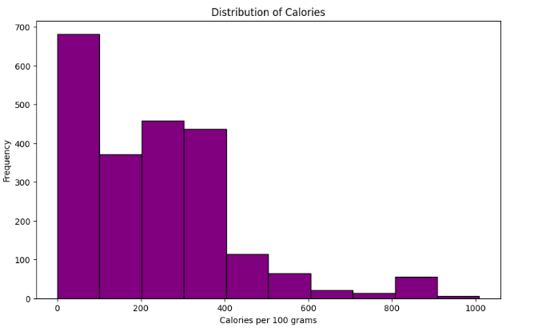
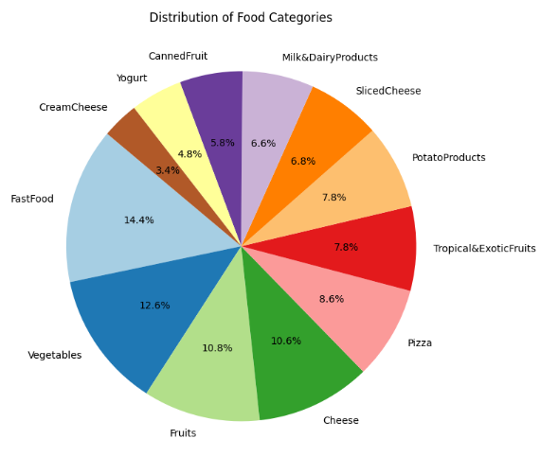
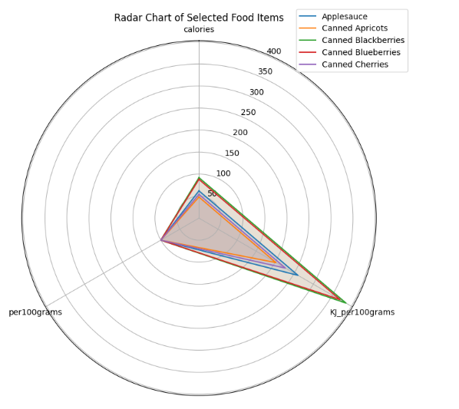
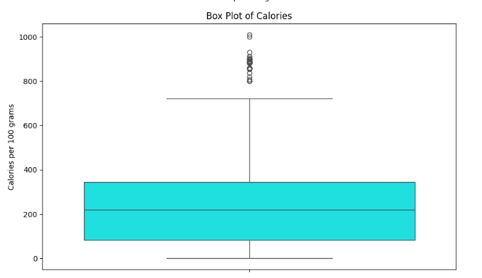
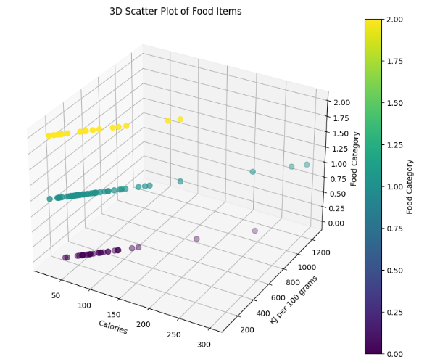

Slide 17
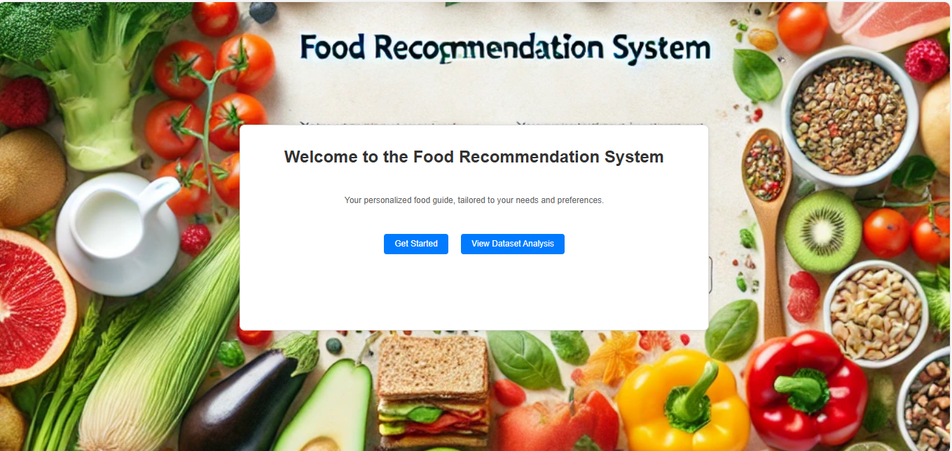
Result and Discussion
The home page of the Food Recommendation System is designed to be both welcoming and easy to navigate, emphasizing its mission to offer personalized dietary advice tailored to individual needs and preferences.
In today's world, where personalized health and nutrition experiences are increasingly valued, this system guides users toward healthier food choices that align with their specific lifestyle goals.
Whether catering to athletes, fitness enthusiasts, or those with dietary restrictions, the system provides relevant and easy-to-understand food recommendations.
The home page design focuses on simplicity and accessibility, with a clean layout, clear typography, and intuitive navigation, ensuring a seamless user experience.
A prominent call-to-action encourages users to explore the system's personalized dietary recommendations, making the home page a crucial entry point for motivating users to improve their well-being.

Slide 18
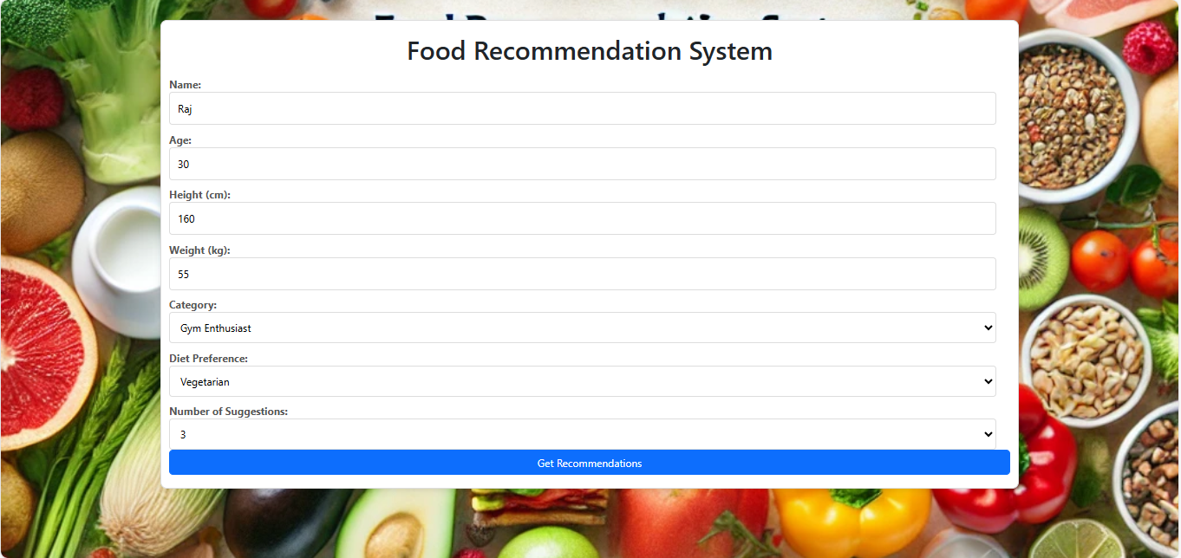
The personalized food recommendation system is a powerful web application built using Flask, a lightweight Python framework, that integrates web development, data processing, and user experience principles to deliver tailored dietary advice.
The application uses a structured dataset of food items to generate personalized recommendations based on user inputs, catering to specific categories like Gym Enthusiast, Sportsman, and Specific Conditions.
User interaction begins on the home page with a straightforward form that collects essential details, such as name, age, height, weight, and dietary needs, before submitting the data via a POST request to the /get-recommendations route.
The system employs a category mapping dictionary to align user-selected categories with relevant food items from the dataset, ensuring recommendations are both personalized and contextually relevant.
A rudimentary scoring mechanism, based on the caloric content of each food item, ranks recommendations, with potential for future expansion to include a broader range of nutritional factors like protein, fats, and vitamins.
Future enhancements could involve integrating machine learning algorithms to refine recommendations by analyzing user feedback and dietary outcomes, evolving the system into a sophisticated tool for long-term health and wellness.

Slide 19
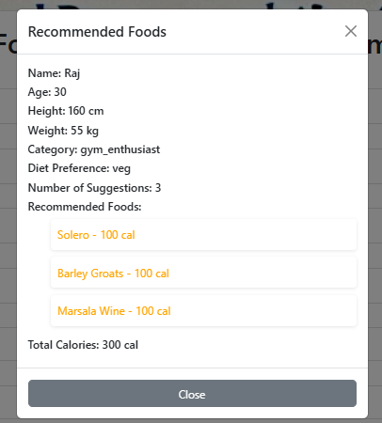
Ethical and privacy considerations are crucial for the Food Recommendation System, as it handles sensitive user data, including personal details and dietary preferences.
To maintain user trust and comply with legal regulations, the application must implement strong security measures such as secure communication protocols, data encryption, and robust authentication mechanisms.
The application should be transparent about its data usage, giving users control over their information, including the ability to delete their data or opt-out of data collection.
Recommendations provided by the system must be grounded in sound nutritional science, ensuring users receive safe and evidence-based guidance.
The user interface of the Food Recommendation System is designed to be simple and user-friendly, featuring a minimalist layout that guides users through the process of entering their details and selecting dietary categories.
Continuous refinement, including user feedback, expansion of the scoring mechanism, and integration of machine learning, will be essential to the application's evolution and long-term success in promoting better health and nutrition.

Slide 20
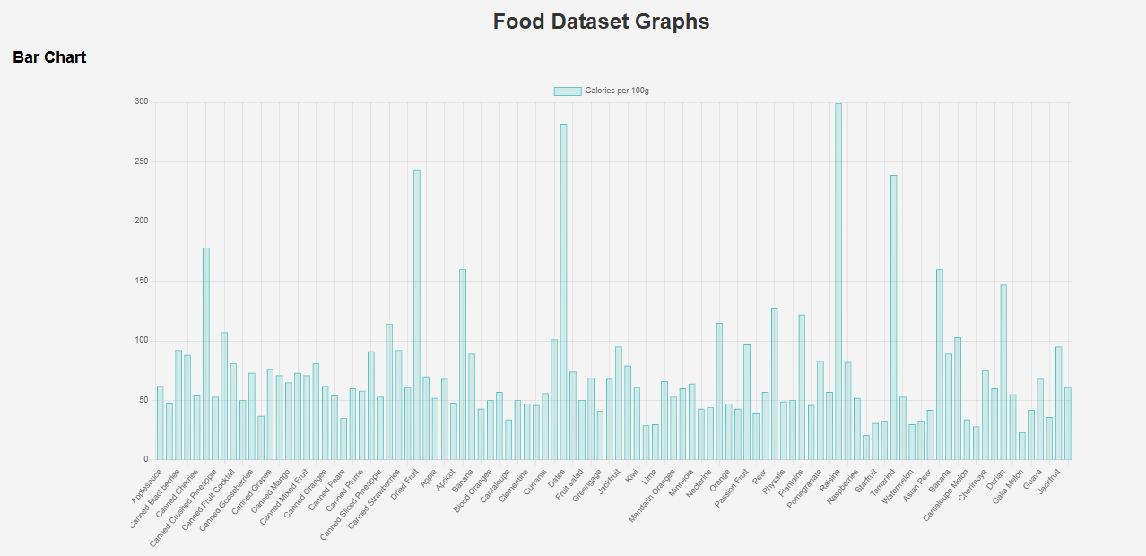
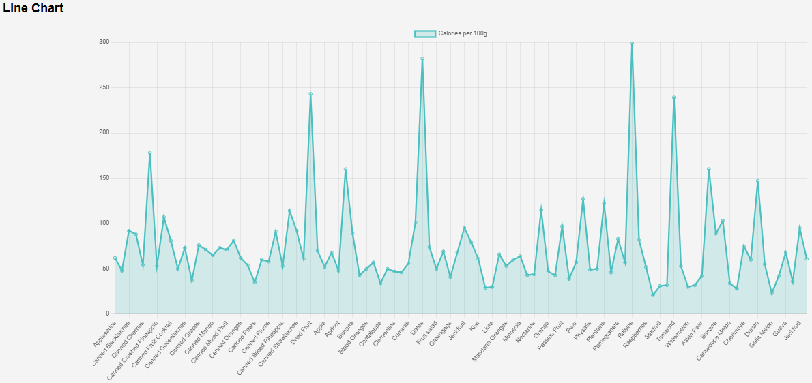
View Dataset Analyses

Slide 21
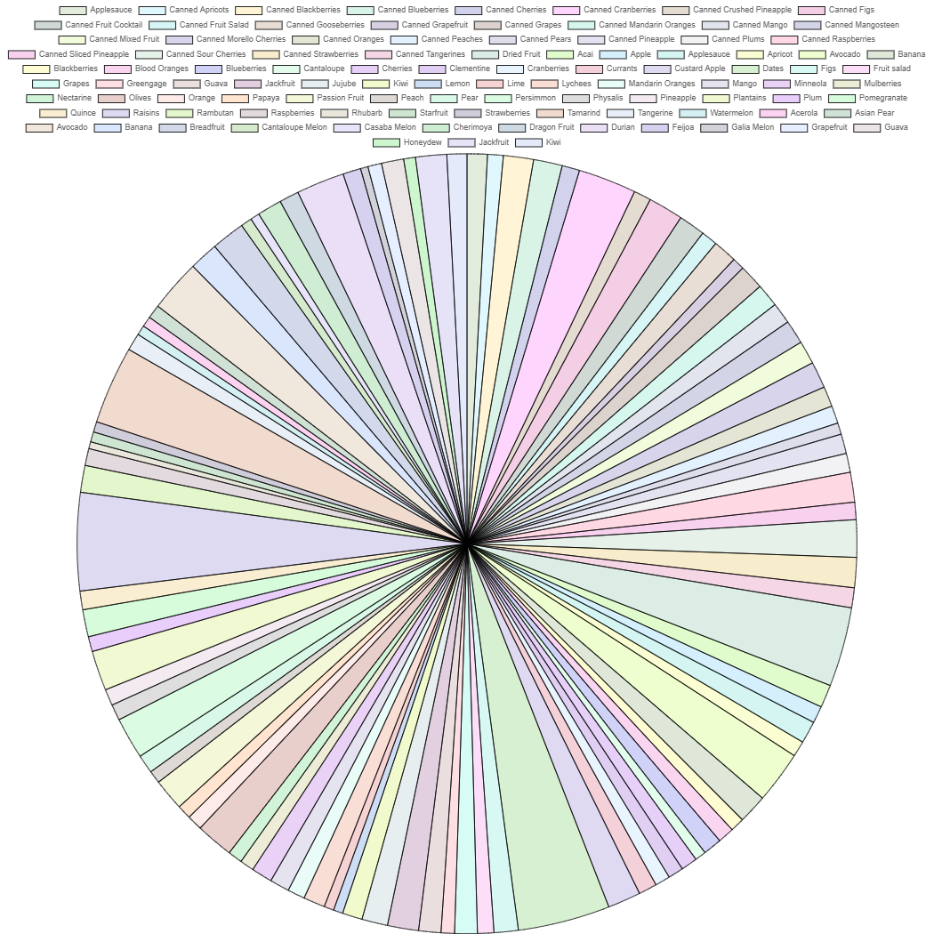
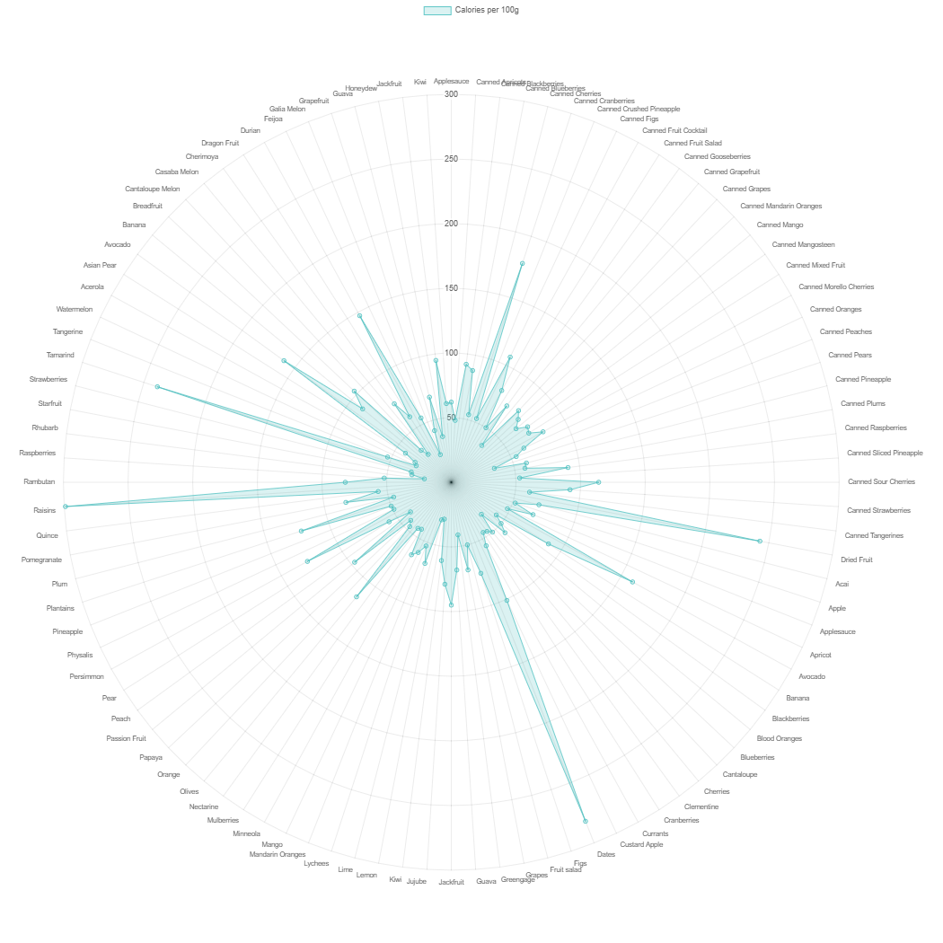
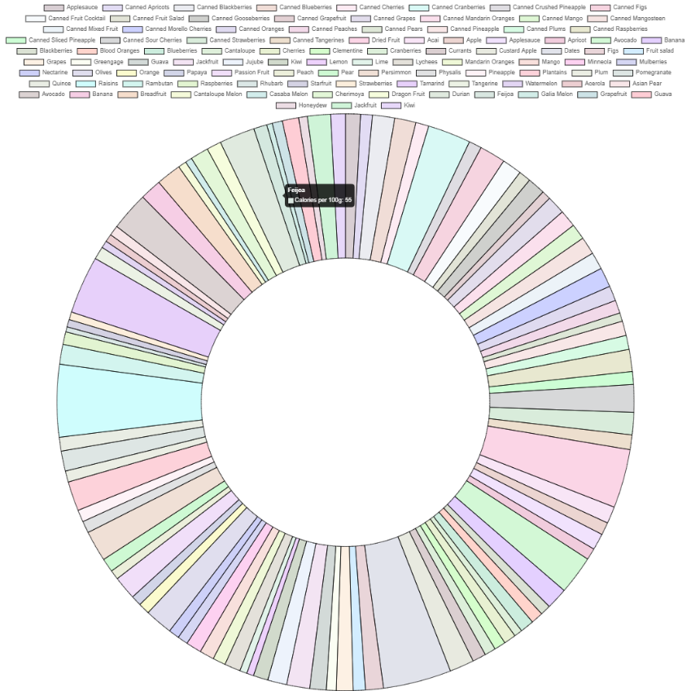
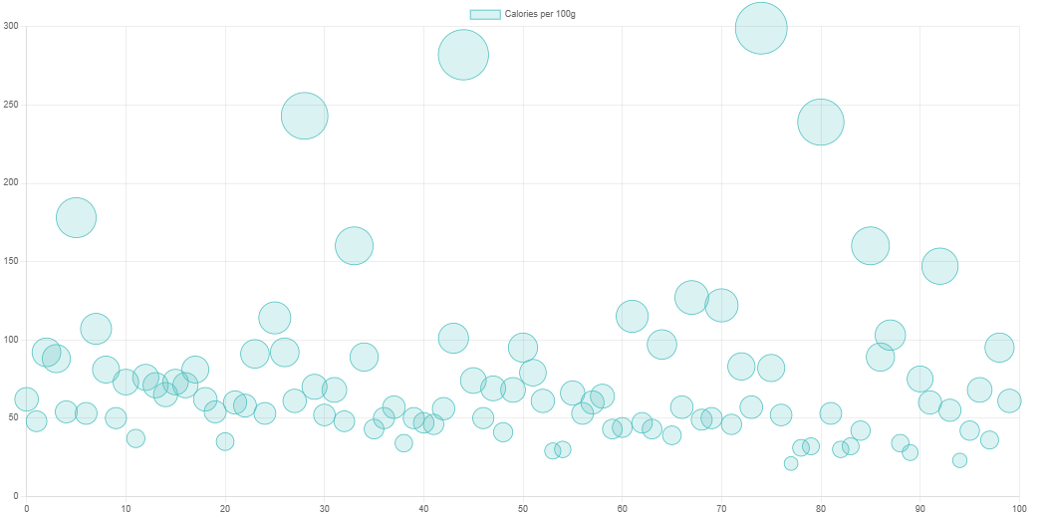
Radar Chart
Doughnut Chart
Pie Chart
Bubble Chart

Slide 22
Discussion on Code Functionality
The application is designed with user-centric principles, ensuring that it tailors dietary recommendations to individual needs, which enhances engagement and satisfaction.
By using Flask, a lightweight and flexible framework, the web application is easy to deploy, manage, and accessible to a wide range of developers due to Python’s popularity.
The dynamic mapping between form categories and dataset categories allows the system to be easily adapted or expanded, ensuring flexibility in incorporating new food categories or user segments.
The current nutritional scoring system focuses on calories, but expanding it to include macronutrients, micronutrients, and other dietary factors would provide more balanced recommendations.
The user interface is functional but could be improved with features like auto-suggestions, dropdown menus, and visual cues to make the experience more engaging and intuitive.
Future directions for the application include integrating machine learning to analyze dietary habits, expanding the dataset for broader applicability, and developing multi-platform accessibility to reach a wider audience.

Slide 23
Recommendations
The Food Suggestions application is a sophisticated system that offers personalized dietary recommendations based on user-specific data, providing a strong foundation for tailored nutrition guidance.
Enhancing the user registration process by adding multi-factor authentication (MFA) and email verification can significantly improve account security, reducing the risk of unauthorized access and ensuring valid user data.
Expanding the range of collected data, such as dietary restrictions and specific health goals, can refine the accuracy of recommendations, aligning them more closely with individual user needs and preferences.
Optimizing database performance through techniques like query optimization, indexing, and using a distributed SQL database can improve scalability and ensure efficient handling of a growing user base.
Integrating machine learning algorithms, such as collaborative filtering and macronutrient analysis, can enhance the recommendation accuracy and provide more balanced and flexible meal suggestions.
Improving the user interface with responsive design, interactive elements, and tooltips, along with integrating popular health and fitness apps, can create a more engaging and seamless user experience.

Slide 24
Conclusion
The Food Suggestions application is a promising tool in the health and wellness sector, designed to provide personalized dietary guidance tailored to individual health parameters and lifestyle choices.
By integrating innovative features like personalized food recommendations, community engagement, and professional support, the application offers a comprehensive and user-friendly experience aimed at improving dietary habits and overall health.
Central to the application’s functionality is the use of user-specific data, such as age, weight, and activity level, to calculate Total Daily Energy Expenditure (TDEE) and provide nutritionally balanced food suggestions.
To enhance user engagement, the application can incorporate features such as personalized notifications, customizable meal plans, and professional guidance from dietitians, which would further personalize and enrich the user experience.
Regular updates, user feedback mechanisms, and the introduction of gamification elements like badges and leaderboards can keep the application relevant, engaging, and aligned with user needs.
The continuous evolution of the Food Suggestions application, guided by user feedback and technological advancements, will ensure its competitiveness in the market and its effectiveness in helping users achieve their health and dietary goals.

Slide 25
Thank You

